Slide 1



Project 3
Group 9: Nichole Yao, Alexandra DeKinder, Yuting Gong, Adam Kravitz

Slide 2
Possible Approaches:
Optimize GBM
More Trees (How many trees should we use?)
Decrease Shrinkage
Implement SVM
Small gamma, high cost? Large gamma, small cost? (gamma = 10^(-2) is too large)
How about a fixed gamma?
Implement CNN?
Research? (For multiple papers that have done a similar project it said that the svm was the best model to use. So we did not use CNN.)

Slide 3
GBM Optimized
Baseline (Fix tree, and change shrinkage):
4.8 % accuracy with 1 tree and shrinkage 0.1
Fix shrinkage, and change trees (8.8%)
Tested trees by 10s, 50s, and 100s
Once reached pasted 500 the error increased (and the time for cross validation took too long )
So we capped the trees at 500
Interaction depth
Set as 2

Slide 4
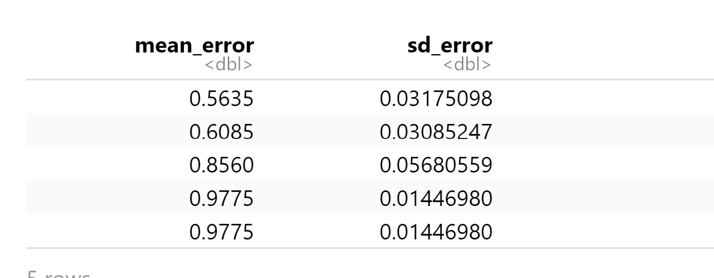
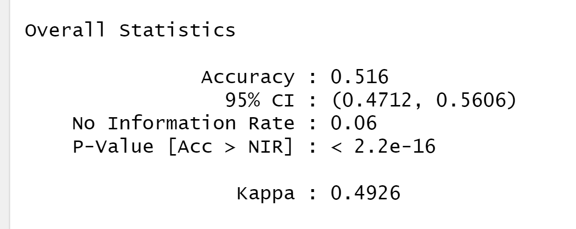
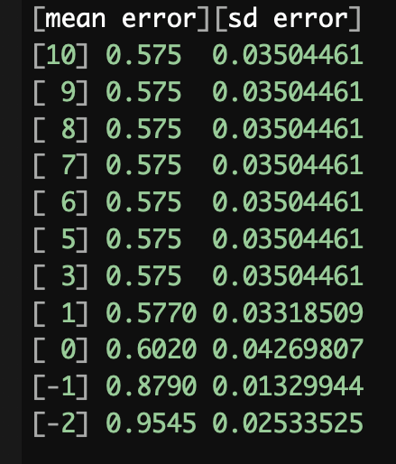
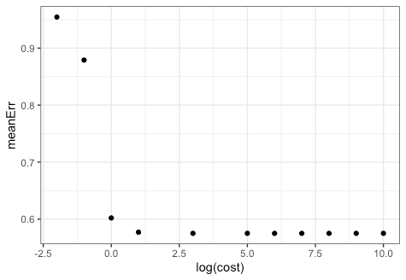
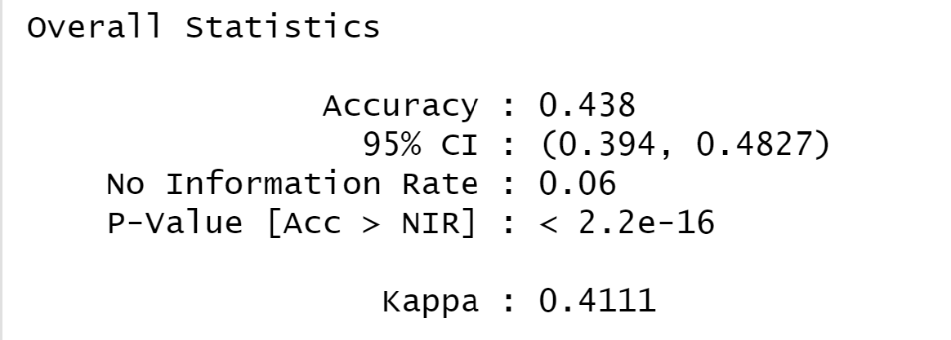
Implement SVM
Gamma – Low gamma, larger spread and visa versa
Cost – Low cost, less penalization of misclassifying and visa versa
Increasing gamma, Decreasing cost? (Gamma: 10^(-5):10^(-1), Cost: 10^(5):10^(1), )
Fixed gamma(1/6006), Decreasing cost?
Higher cost more accurate: 42.5% (10^5),
Lowest cost 0.455% accuracy with (10^(-2))
Best cost seems to be at 10^1 without it
being too high of a cost

Slide 5
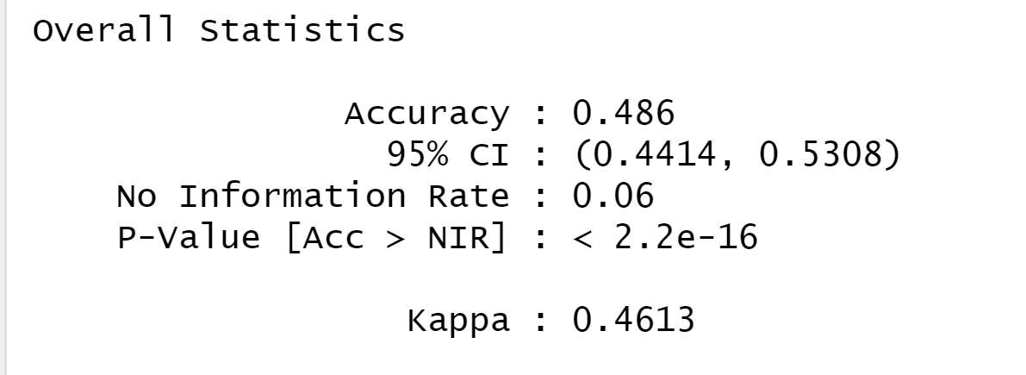
Implement SVM Cont.
Increasing gamma, Fixed cost (10^(1))?
Lowest gamma accuracy: 39.4% at (10^(-5))
Higher gamma less accurate: 0.225% (10^-2),

Slide 6
Conclusion:
SVM Increasing gamma, Decreasing cost, were the best parameters that we found for svm.
Basline = 4.8 % accurate
Best parameters for SVM on testing data = 51.6% accurate
GBM testing data = 8.8% accurate

